Slide 1
Implementing a library
Demo

Slide 2
Agenda
Previous session
Revisited arrays – how to “grow” an array to insert a new value
Introduction to collections
Basic overview of generics - The diamond operator <>
ArrayList
Primitives and auto boxing/unboxing
ListIterator
Collections algorithms
Today
Collections of objects
ArrayLists (again) – Always the right tool for the job?
Introduction to HashMaps
Library of Books example
Authors and Books example
Lecture: Library Demo
2

Slide 3

Example
Library and Books
Lecture: Library Demo
3

Slide 4
Collections
Let’s create a Library of Books
A library contains many books, a book belongs to one library
Library
Book
- catalogue
*
How do we manage this relationship in Java?
We’ve seen arrays (week 7) – however they’re limited because they’re of a fixed size
We’ve seen ArrayList (week 8) - more convenient that arrays because they can grow and shrink in size
Lecture: Library Demo
4

Slide 5
Library and Book class example
class Book {
private int numOfPages;
private int priceInPence;
private String isbn;
private char genre;
public Book(int n, int p, String i) {
this(n, p, i, 'G');
}
public Book(int n, int p, String i, char g) {
numOfPages = n;
priceInPence = p;
isbn = i;
genre = g;
}
// ... other method(s) ...
}
Lecture: Library Demo
5

Slide 6
Library using ArrayList
Create an empty ArrayList to store our collection of Book objects.
public class Library {
private List<Book> catelogue = new ArrayList<>();
// ... constructor ...
public void addBook(Book b) {
catelogue.add(b); // might want to check if we have it already
}
public boolean hasBookInStock(String isbn) {
for(Book b : catelogue) { // Search through all the books in a sequence
if(b.getIsbn().equals(isbn)) {
return true;
}
}
return false;
}
}
Define a method to add a book object to our collection. Might want to check if we already have it.
Provide Library users the ability to query if the library has a book by its ISBN.
This is OK
The downside is that we might have to search every book to find the one that we’re looking for – on small numbers this might be fine
Lecture: Library Demo
6

Slide 7
Library using ArrayList
public class Library {
// ... as previous slide ...
public Book findBookByIsbn(String isbn) {
for(Book b : catelogue) { // Search through all the books in a sequence
if(b.getIsbn().equals(isbn)) {
return b;
}
}
return null; // Not found
}
}
Provide Library users the ability to “borrow” a book if the library has a book by its ISBN.
This is OK
The downside is that we might have to search every book to find the one that we’re looking for – on small numbers this might be fine
Lecture: Library Demo
7

Slide 8
The position in the list
0
Java Programming – Early Objects
1
How to draw a pair of curtains
2
A beginner’s guide to Powerpoint
All the books we need to inspect
…
…
The book we’re looking for
1000000
Last Book You’ll Ever Read
Lecture: Library Demo
8

Slide 9
Map types
Java also provides (key, value) pair collection types
The key is used to “lookup” the value – think telephone directory, using the persons name to lookup their phone number
One such class is HashMap (documentation link)
Key
Value
HashMap<String, String> phoneDirectory = new HashMap<>();
Key
Value
phoneDirectory.put("Bob", "+44120373638");
phoneDirectory.put("Sue", "+1555373638");
Key
System.out.println("Sue's number is: " + phoneDirectory.get("Sue"));
Lecture: Library Demo
9

Slide 10
Library using HashMap
Create an empty HashMap to store our collection of Book objects.
class Library {
private HashMap<String, Book> catelogue = new HashMap<>();
// ... constructor ...
public void addBook(Book b) {
catelogue.put(b.getIsbn(), b); // might want to check if we have it already
}
public boolean hasBookInStock(String isbn) {
return catelogue.containsKey(isbn);
}
public Book findBookByIsbn(String isbn) {
return catelogue.get(isbn); // returns null if is isn't in the catelogue
}
}
Add a new book object to our catalogue – probably should check if it already exists in the collection.
Key
Value
The HashMap provides quick access to the data by using a unique key (in this case the ISBN)
Key
Key
Lecture: Library Demo
10

Slide 11
Library using HashMap
Key (ISBN) | Value (Book)
"1617293296" | Book()
"1292018194" | Book()
… | …
Library library = new Library();
Book b1 = new Book(334, 18.50, "1617293296");
Book b2 = new Book(1240, 26.22, "1292018194", 'T');
library.addBook(b1);
library.addBook(b2);
Book myBook = library.findBookByIsbn("1617293296");
Lecture: Library Demo
11

Slide 12
Accessing all the values
HashMap (and other Map types) provide a method called values() that returns a collection containing the values – for example, display the libraries catalogue:
class Library {
private HashMap<String, Book> catelogue = new HashMap<>();
// ... constructor(s) and other methods ...
public void printCatalogue() {
for(Book b : catelogue.values()) {
System.out.println(b.getIsbn() + " - " + b.getPages());
}
}
}
Lecture: Library Demo
12

Slide 13

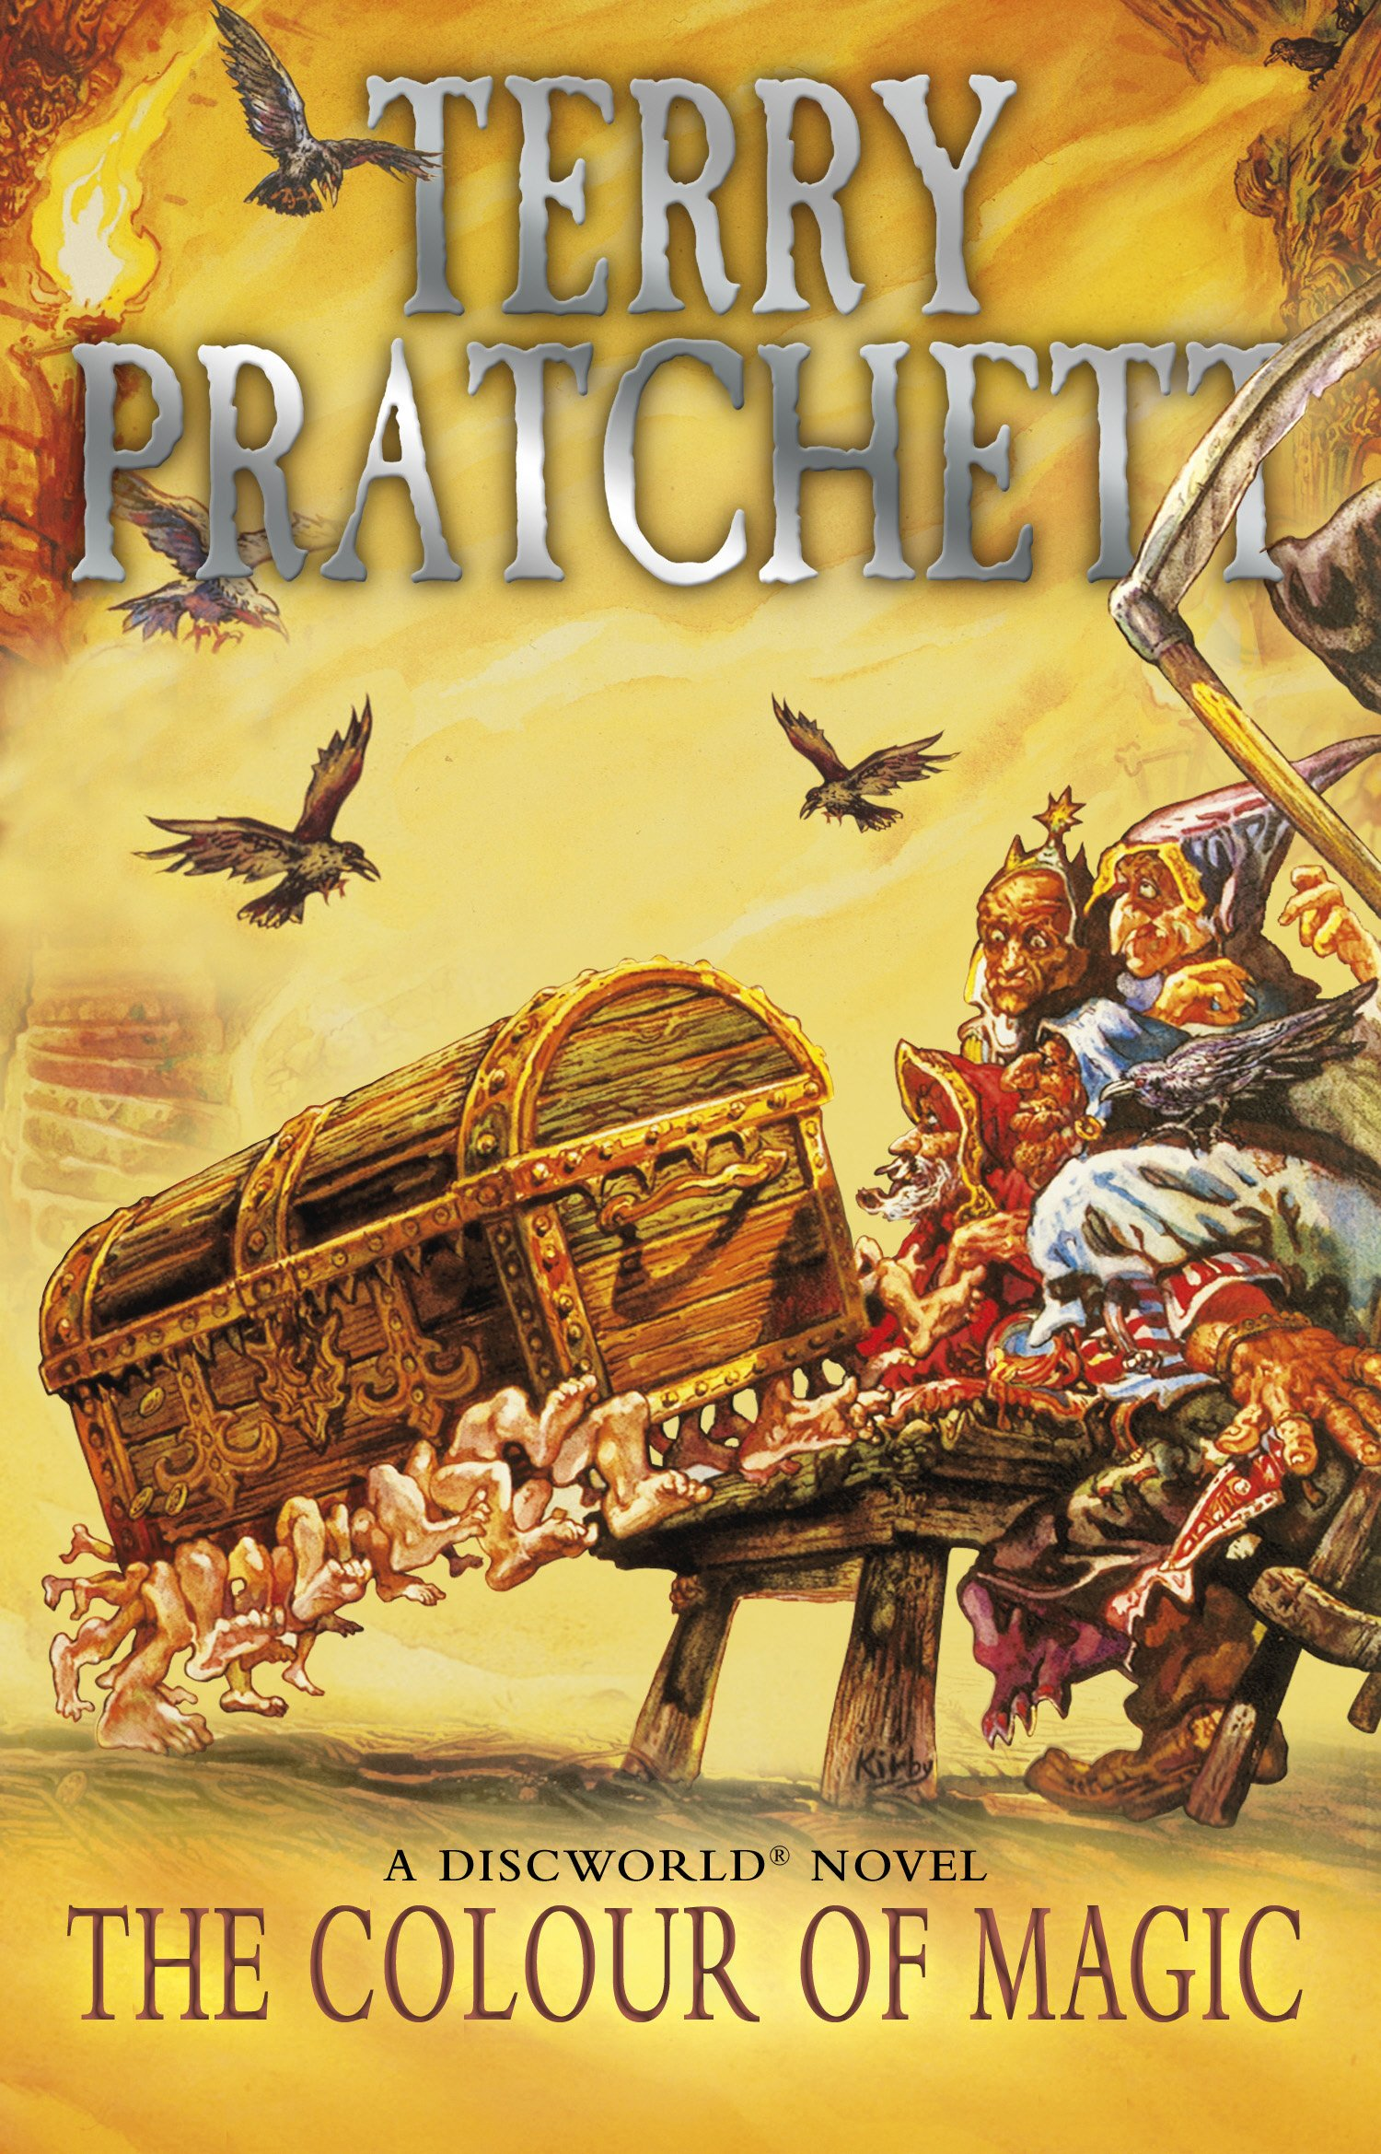
Example
Authors and Books
Lecture: Library Demo
13

Slide 14
Collections both sides
If the problem requires, there could collections at both ends
For example, Books and their Authors
Books have many Authors
Authors have many Books
Author
- fname: String - lname: String - dob: Date … other attributes …
+ getFullName(): String + getDOB(): Date + getPublications(): Book[] … other methods …
Book
- numOfPages: int - title: String - publicationDate: Date … other attributes …
+ addAuthor(a: Author): void + getAuthors(): Author[] … other methods …
*
- publications: HashMap
- authors: ArrayList
*
Lecture: Library Demo
14

Slide 15
Books and Authors
For the purposes of the example
A Book will have an ArrayList of Authors – because it is unlikely that a book will have a huge number of authors
An Author will have a HashMap of Books – because an author could have published lots of Books – including lots of editions of books, each with their own ISBN and other differences
Lecture: Library Demo
15

Slide 16
Book.java
public class Book implements Comparable<Book> {
private int numOfPages;
private String title;
private String isbn;
private LocalDate publicationDate;
// ... other relevant instance variables ...
private ArrayList<Author> authors = new ArrayList<>();
public Book(int numOfPages, String isbn, String title, LocalDate pubDate) {
this.numOfPages = numOfPages;
this.isbn = isbn;
this.title = title;
publicationDate = pubDate;
}
public void addAuthor(Author author) {
authors.add(author);
}
public ArrayList<Author> getAuthors() {
return authors;
}
// ... other relevant methods ...
}
Implementation Comparable interface so that we can sort our books.
This declaration defines the association between a Book object and its Authors
Allows the client access to an Book instance’s authors.
There is a problem here though.
What might it be?
Implementation of addAuthor() – should check if author already in list
Lecture: Library Demo
16

Slide 17
Author.java
public class Author {
private String fname;
private String lname;
private LocalDate dateOfBirth;
// ... other relevant instance variables ...
private HashMap<String, Book> publications = new HashMap<>();
public String getFullName() {
return fname + " " + lname;
}
public void addPublication(Book book) {
publications.put(book.getIsbn(), book);
}
public ArrayList<Book> getPublications() {
// Iterative solution to generate a list from the value
ArrayList<Book> list = new ArrayList<>();
for(Book b : publications.values()) {
list.add(b);
}
// Sort the publications by their date
Collections.sort(list);
return list;
}
}
This declaration defines the association between an Author object and its Books – this case, a key-value pairing (ISBN, BOOK)
Implementation of addPublication()
Because we’re using a HashMap, which requires a key to map onto the value (a book) – The Book’s ISBN is being used as the key.
In this example – we’re going to return a list of the book, rather than the HashMap.
This is for illustrative purposes mainly.
Lecture: Library Demo
17

